Slide 1


Dmart Customer Segmentation with Machine Learning
This presentation outlines a machine learning project focused on customer segmentation using Dmart sales data. The aim is to understand customer behavior by grouping them based on purchasing patterns, product categories, quantities, and spending habits. Analyzing these perspectives provides valuable insights for targeted marketing and business strategy optimization. We'll explore the workflow, data preprocessing, cluster analysis, and model training steps involved in this project.
by Sankari C

Slide 2
Project Workflow Overview
Dataset Acquisition
1
The project begins with acquiring the Dmart sales dataset, which contains transactional information about customer purchases, product details, and quantities.
2
Data Preprocessing
Raw data is cleaned, transformed, and prepared for analysis. This involves handling missing values, feature selection, and data type conversions.
Data Analysis
3
Exploratory data analysis (EDA) is conducted to understand the distribution of features, identify patterns, and gain insights into customer behavior.
4
K-Means Clustering
The K-means algorithm is trained on the preprocessed data to group customers into distinct clusters based on their purchasing behavior.
Visualization and Analysis
5
The resulting clusters are visualized and analyzed to identify patterns, characteristics, and relationships between customer segments and product categories.

Slide 3
Loading and Inspecting the Dataset
Loading the Data
First 5 Rows
Checking the Shape
The initial step involves loading the Dmart sales dataset into a suitable data structure, such as a Pandas DataFrame, for further processing.
Printing the first 5 rows of the DataFrame to get a glimpse of the data structure and the nature of the data.
Determining the number of rows and columns in the dataset to understand its size and dimensionality.

Slide 4
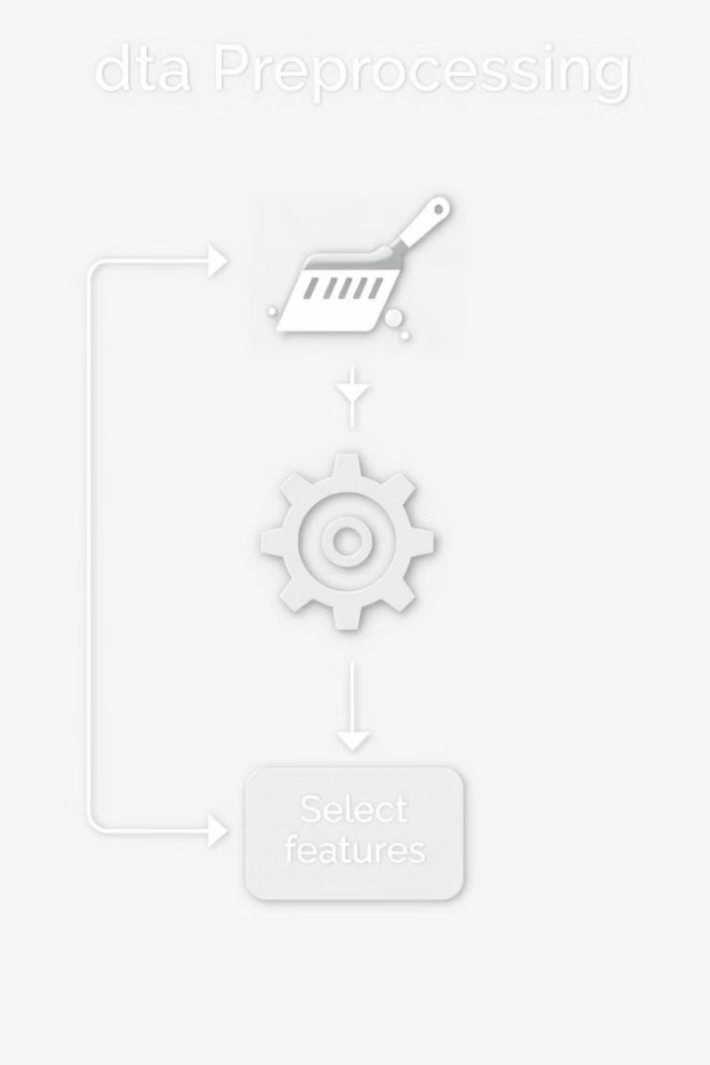
Data Preprocessing Steps
Handling Missing Values
Feature Selection
Identifying and addressing missing values in the dataset, either by imputation or removal, to ensure data quality and integrity.
Selecting relevant features for clustering, such as product categories, unit prices, quantities, and total prices, while excluding irrelevant or redundant features.
Data Slicing
Slicing the DataFrame to extract the selected features into a new data structure for subsequent standardization and clustering.

Slide 5
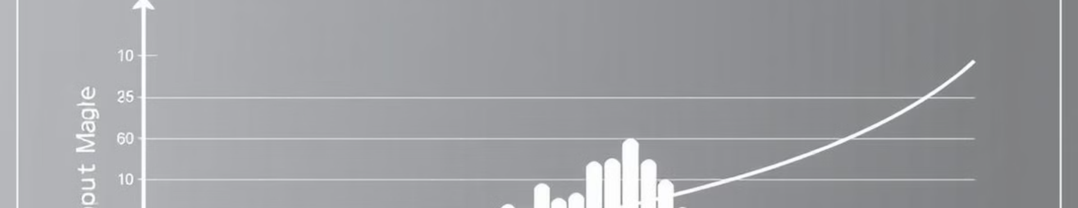
Standardizing the Data
Standardizing the selected features using techniques like StandardScaler to ensure that all features have a similar scale and distribution. This prevents features with larger values from dominating the clustering process.
Standardization involves transforming the data so that it has a mean of zero and a standard deviation of one. This ensures that each feature contributes equally to the distance calculations in the clustering algorithm.
By standardizing the data, we improve the accuracy and reliability of the clustering results, leading to more meaningful customer segments.

Slide 6




Finding the Optimal Number of Clusters
WCSS Calculation
Elbow Method
Visual Inspection
WCSS (Within-Cluster Sum of Squares) measures the sum of squared distances between each data point and its assigned cluster centroid. Lower WCSS values indicate tighter clusters.
The elbow method involves plotting WCSS values against different numbers of clusters (k) and identifying the "elbow" point where the rate of decrease in WCSS starts to diminish. This point represents the optimal number of clusters.
Visualizing the elbow graph allows for easy identification of the optimal cluster point, providing a visual representation of the trade-off between the number of clusters and the tightness of the clustering.

Slide 7

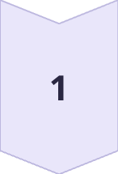
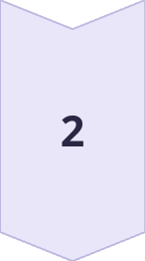
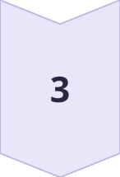
Training the K-Means Clustering Model
Initialization
Initialize the K-means clustering algorithm with the determined optimal number of clusters (k).
Model Fitting
Fit the K-means model to the standardized data, allowing the algorithm to learn the cluster centroids and assign data points to the nearest cluster.
Cluster Assignment
Assign each data point (customer) to its corresponding cluster based on the learned cluster centroids.

Slide 8



Analyzing and Visualizing Clusters
Visualization
Visualize the clusters using scatter plots visualization techniques to gain insights into the relationships between features and cluster assignments.
Cluster Profiling
2
Analyze the characteristics of each cluster, such as average spending, product preferences, and purchase frequency, to understand the behavior of different customer segments.
1
Relationship Analysis
Explore the relationships between cluster assignments and feature values to identify patterns and trends that differentiate customer segments by pairplots.
3

